Slide 1
Distinguished Club Program (DCP) - 60 mins -

Slide 2
Agenda
Concept of MOT, CSP and DCP
Moments of Truth
Distinguished Club Program

Slide 3



Club Success Plan (CSP)
1. Delivering a speech in every 2 weeks
2. Run with pace maker
Distinguished Club Program (DCP)
1. D93 International
Speech Contest Winner
2. 10km marathon in 1 hour
1. No awards at Speech Contest
1 year
Moments of Truth (MOT)
2. 5km marathon in 40mins
30. June 2021
1. July 2020

Slide 4
MOT, CSP and DCP
Distinguished Club Program
Where you want to be
Club Success Plan
How to get there
Moments of Truth
Where you are

Slide 5

Moments of Truth
- Six Categories
- Min 1point to Max 5 point
- Discuss topics which get 3 or less points
- Club Officers (with Members)
- 1 hour to 1.5 hours depending on the club

Slide 6


Moments of Truth - link
https://bit.ly/2ZtJYTG
1. Have a “Moments of Truth” session within in a club with the link
2. Submit the result of“Moments of Truth” to District
3. Wait for “Toastmasters Core Values Coin - 10ea” to your club

Slide 7
Moments of Truth – 6 Categories
First Impression
Fellowship, Variety, and Communication
Membership Orientation
Program Planning and Meeting Organization
Achievement Recognition
Membership Strength

Slide 8
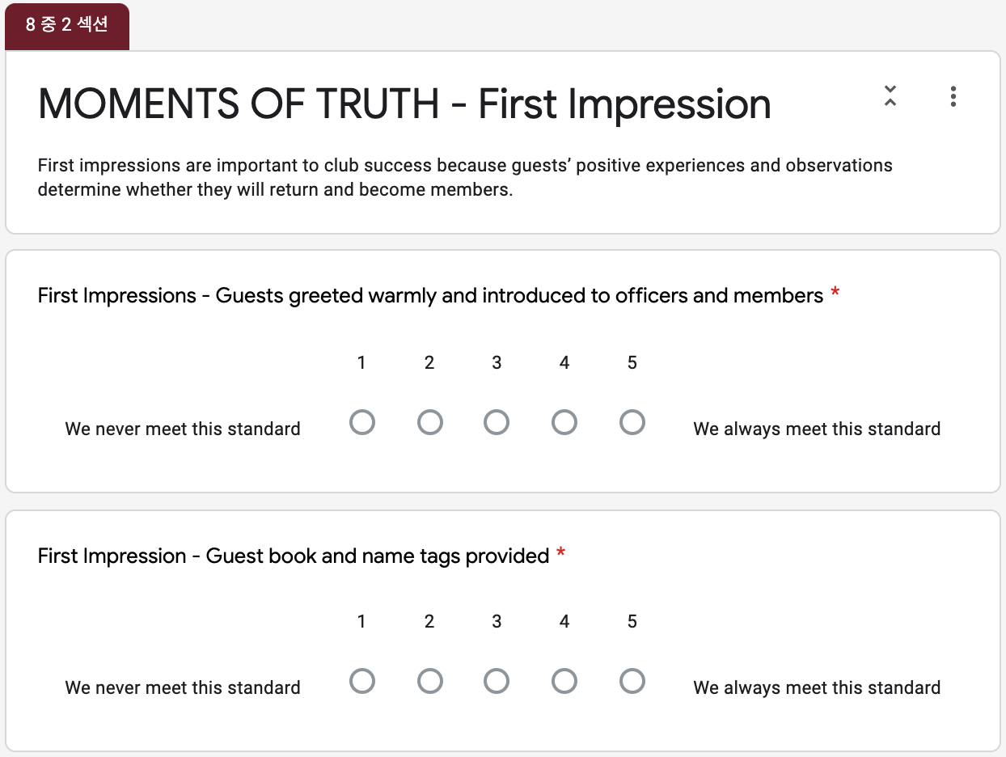
MOT – First Impression
Ave. 6 questions
per category

Slide 9
Moments of Truth - link
https://bit.ly/2ZtJYTG
1. Have a “Moments of Truth” session within in a club with the link
2. Submit the result of“Moments of Truth” to District
3. Wait for “Toastmasters Core Values Coin - 10ea” to your club
By the end of Aug

Slide 10
Club Success Plan
- Just DO it!
- Club Officers
Club Success Plan Download in English
Club Success Plan Download in Korean

Slide 11

Distinguished Club Program
Education - 6 goals
Membership - 2 goals
Leadership - 2 goals

Slide 12
Moments of Truth – MOT vs. DCP
First Impression
Fellowship, Variety, and Communication
Membership Orientation
Program Planning and Meeting Organization
Achievement Recognition
Membership Strength
Club Leadership
Education
Membership

Slide 13
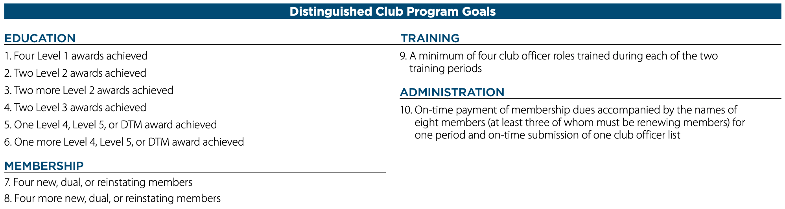
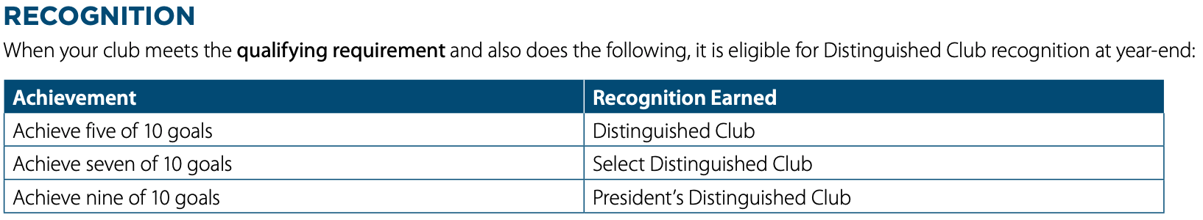
Distinguished Club Program
District 93 Dashboard

Slide 14
Q & A
Any questions about
MOT, CSP and DCP?

Slide 15
Best Practice Sharing

Slide 16
Leadership is all about emotional intelligence. Management is taught, while leadership is experienced. - Rajeev Suri, CEO of Nokia -

